Slide 1
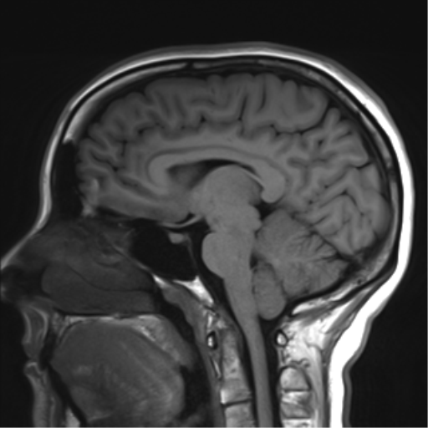
Cerebellum

Slide 2
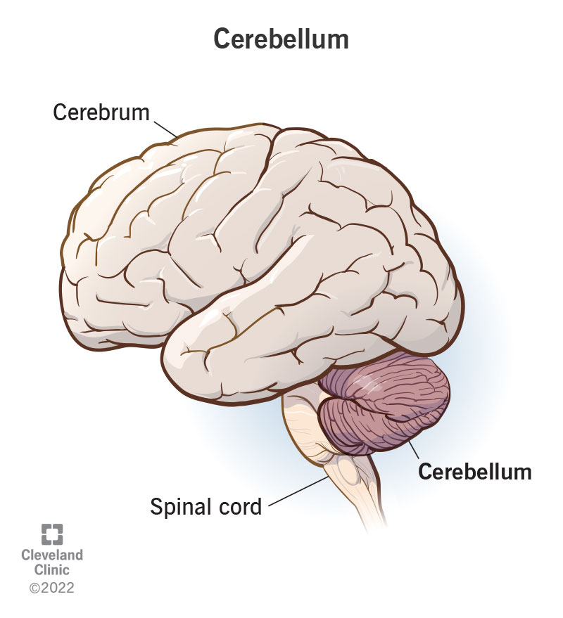
The cerebellum refines actions
Cerebellum
Motor
Cortex
Present
Movements
Body
Voluntary
Movement
Commands
Future
Movements
Proprioceptive
Sensory
Information
Refinement and coordination of current body movement
Refinement of future actions through learning

Slide 3
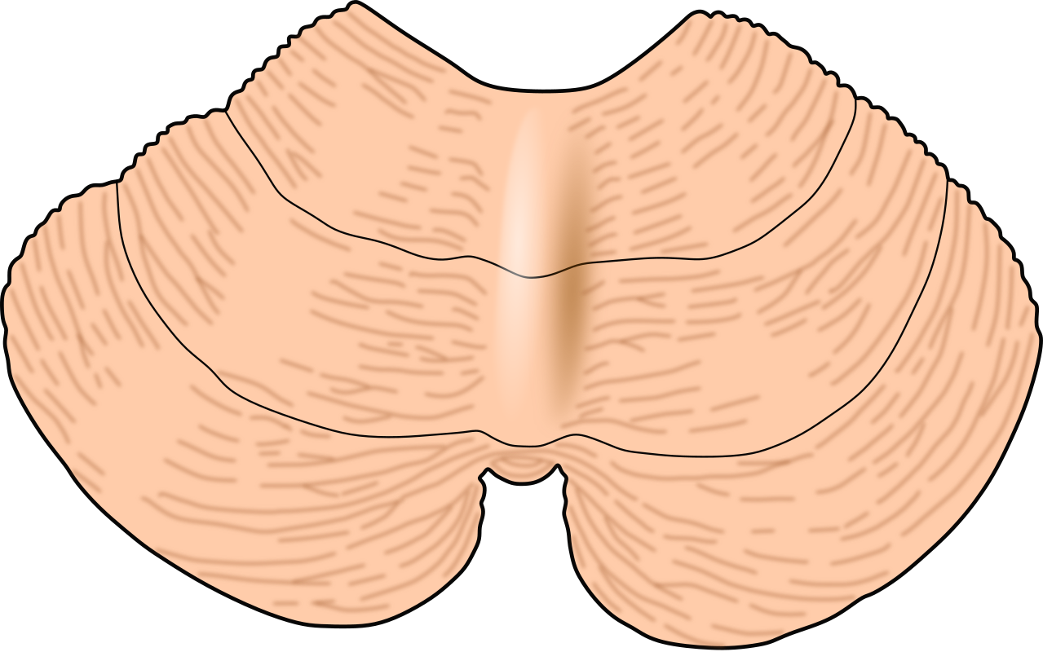
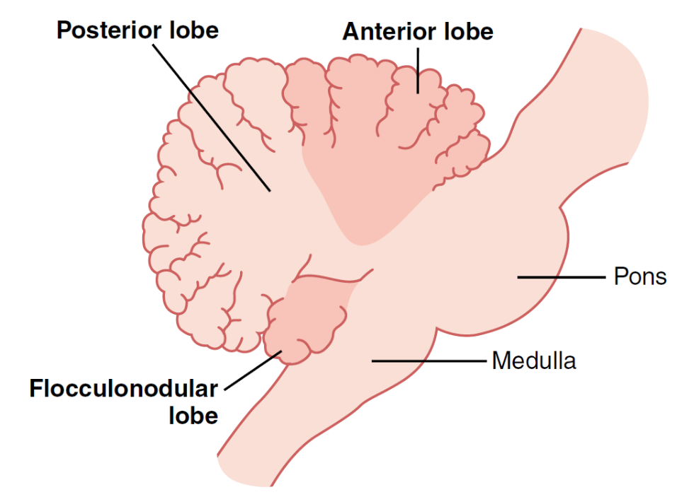
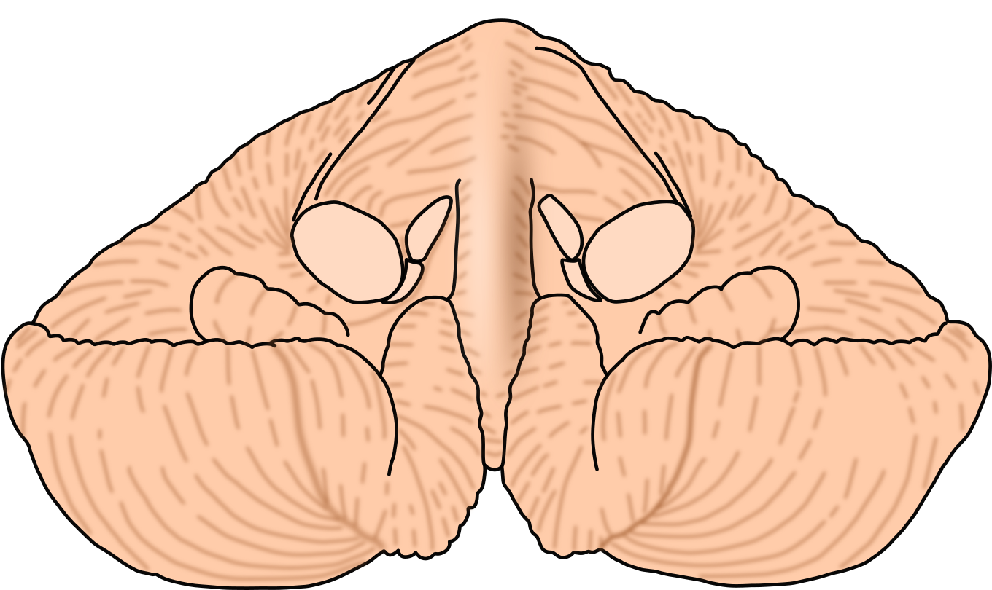
Gross cerebellar anatomy
Anterior Lobe
Left hemisphere
Right hemisphere
Vermis
Primary fissure
Back view
Posterior Lobe
Nodule
Cerebellar
Peduncles
Front view
Flocculus
About 80% of the cortex (around 17 cm x 120 cm surface)
(surface grey matter) is hidden from view on the surfaces of the folia.
Right hemisphere
Left hemisphere
Notes:
The cerebellum is made up of two hemispheres connected by
the vermis in the midline (Fig. 3.16). The vermis is distinct
only on the undersurface, where it occupies the floor of a
deep groove, the vallecula. The hemispheres show numerous
deep fissures, with folia in between. About 80% of the cortex
(surface grey matter) is hidden from view on the surfaces of
the folia.
The oldest part of the cerebellum (present even in fishes) is the
flocculonodular lobe consisting of the nodule of the vermis and
the flocculus in the hemisphere on each side. More recent is the
anterior lobe, which is bounded posteriorly by the primary fissure
and contains the pyramis and the uvula. The most recent is
the posterior lobe. Prominent features of the posterior lobe are
the tonsils. The tonsils lie directly above the foramen magnum of
the skull; if the intracranial pressure is raised (e.g., by a brain
tumour), one or both tonsils may descend into the foramen and
pose a threat to life by compressing the medulla oblongata.
The white matter contains several deep nuclei. The largest of
these is the dentate nucleus

Slide 4
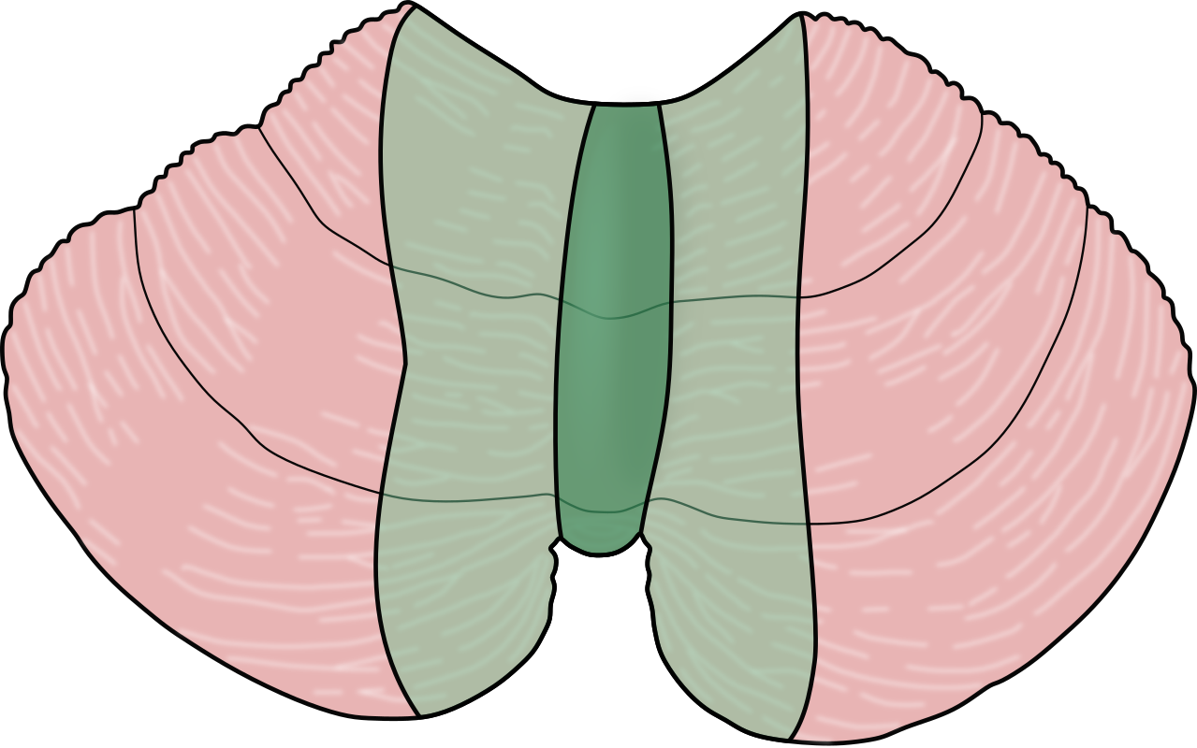
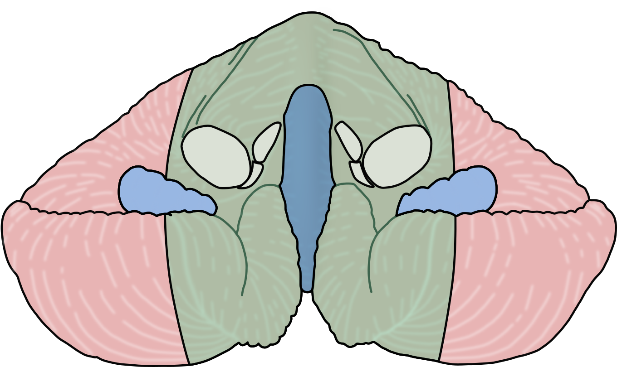
Different cerebellar areas and functions
Back view
Front view
Vestibulocerebellum
(Nodule + flocculus)
Spinocerebellum
(Intermediate zone +
Vermis)
Neocerebellum
(Lateral zone)
Equilibrium during
movement
Proprioception
Movement
Planning and coordination
of future motor actions
Notes:
Phylogenetically, the initial development of the cerebellum (in
fish) took place in relation to the vestibular labyrinth. With the
development of quadrupedal locomotion, the anterior lobes of
the cerebellum (in particular) became richly connected to the
spinal cord. Assumption of the erect posture and achievement
of a whole new range of physical and cognitive skills have been
accompanied by the appearance of massive linkages between
the anterior and posterior lobes of the cerebellum and the cerebral
cortex. In general, cerebellar connections with the vestibular
system, spinal cord, and cerebral cortex are arranged such
that each cerebellar hemisphere is primarily concerned with the
coordination of movements ipsilaterally.
The gross anatomy of the cerebellum is described briefly in
Chapter 3, where it may be reviewed at this time.
FUNCTIONAL

Slide 5
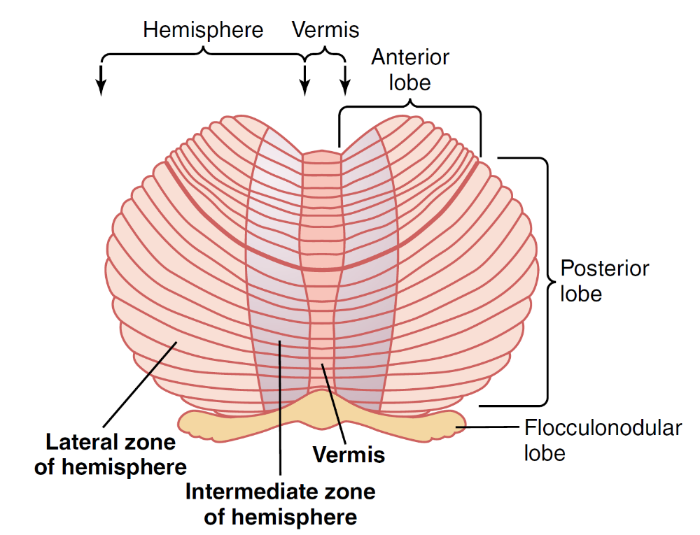
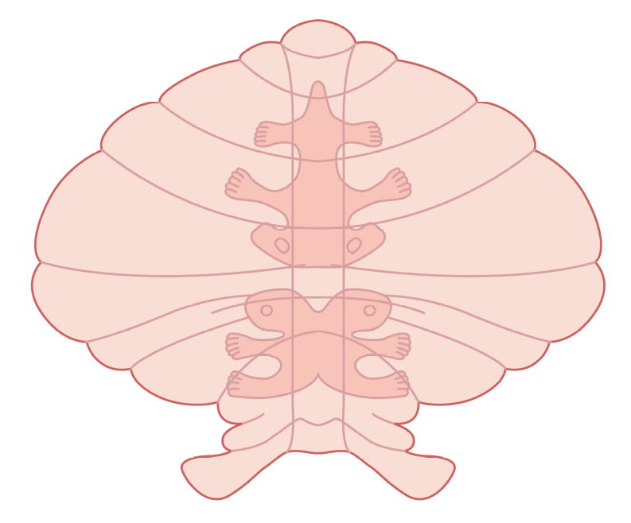
Different cerebellar areas and functions
Inputs :
Premotor area
Somatosensory cortex
Cortical associative areas
Somatotopic
Organization of
Cerebellar cortex
Inputs:
Proprioception
Motor cortex

Slide 6
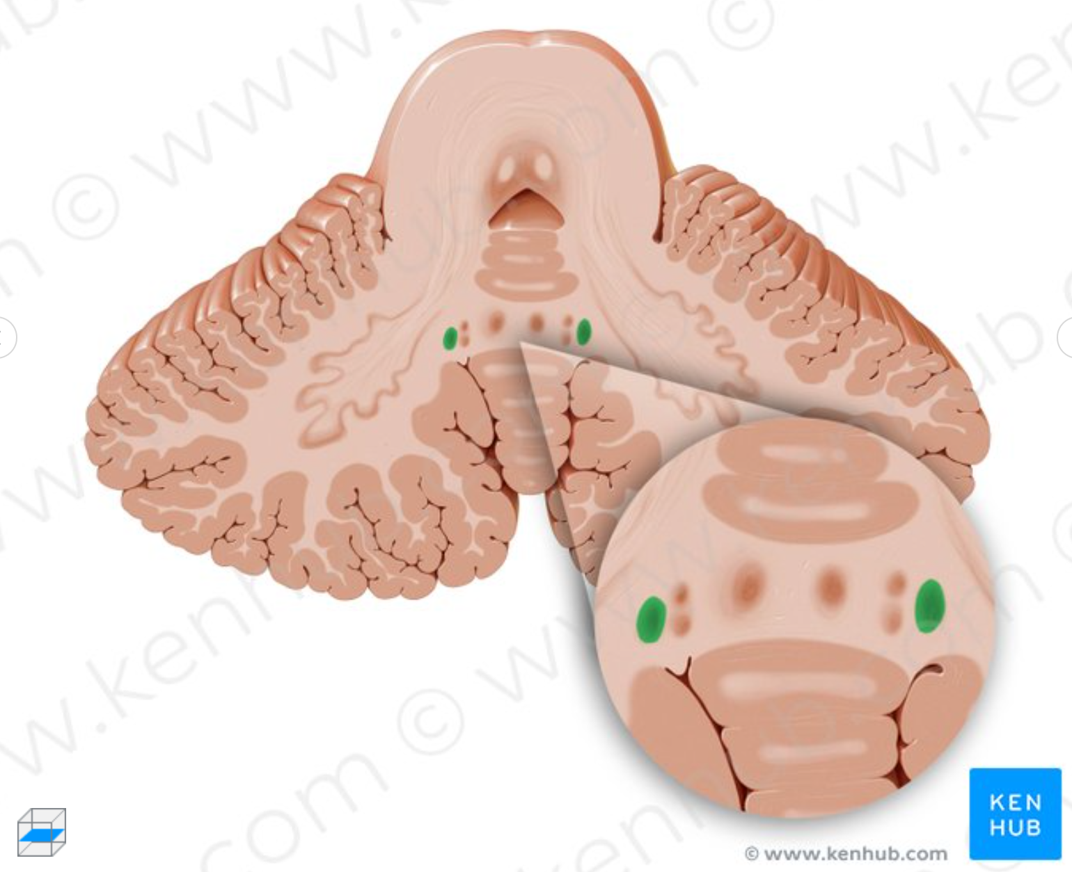
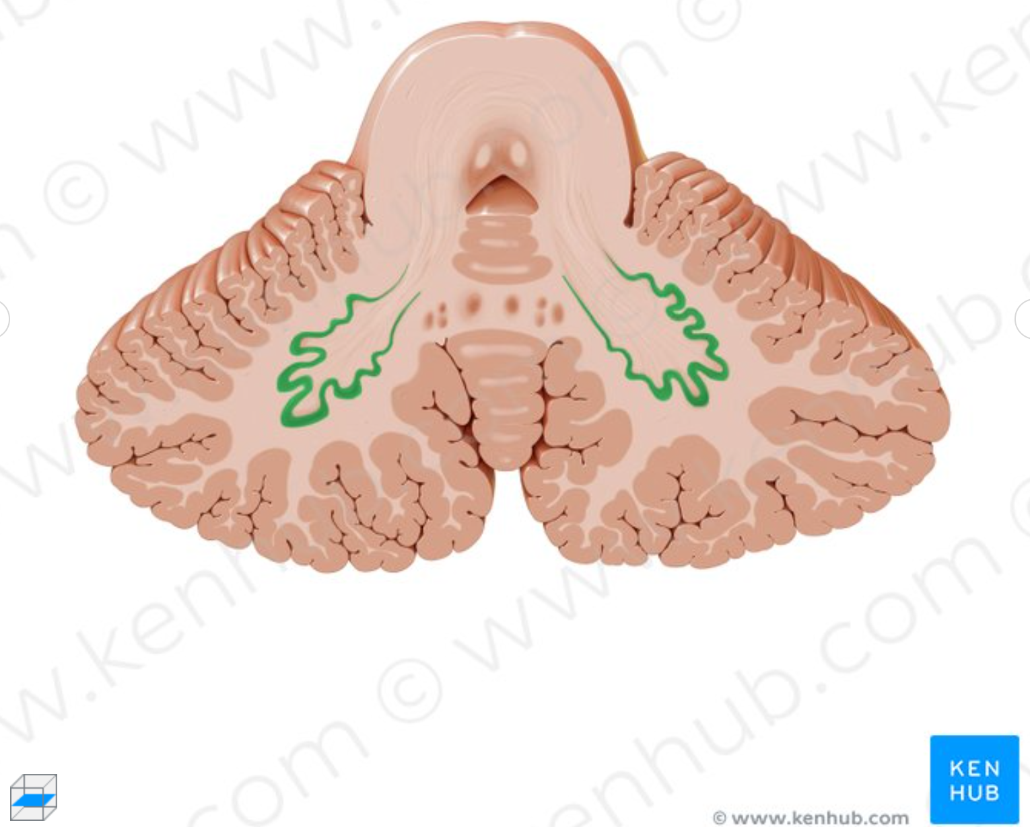
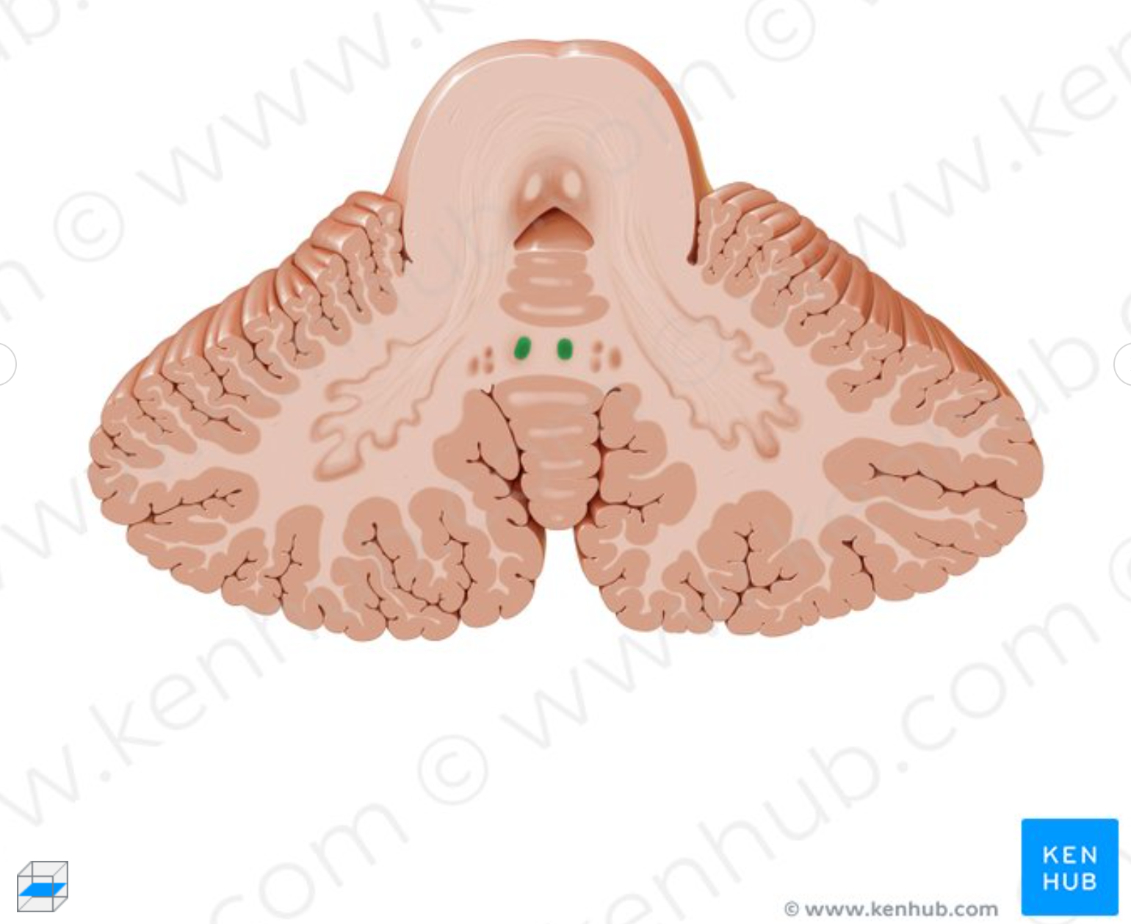
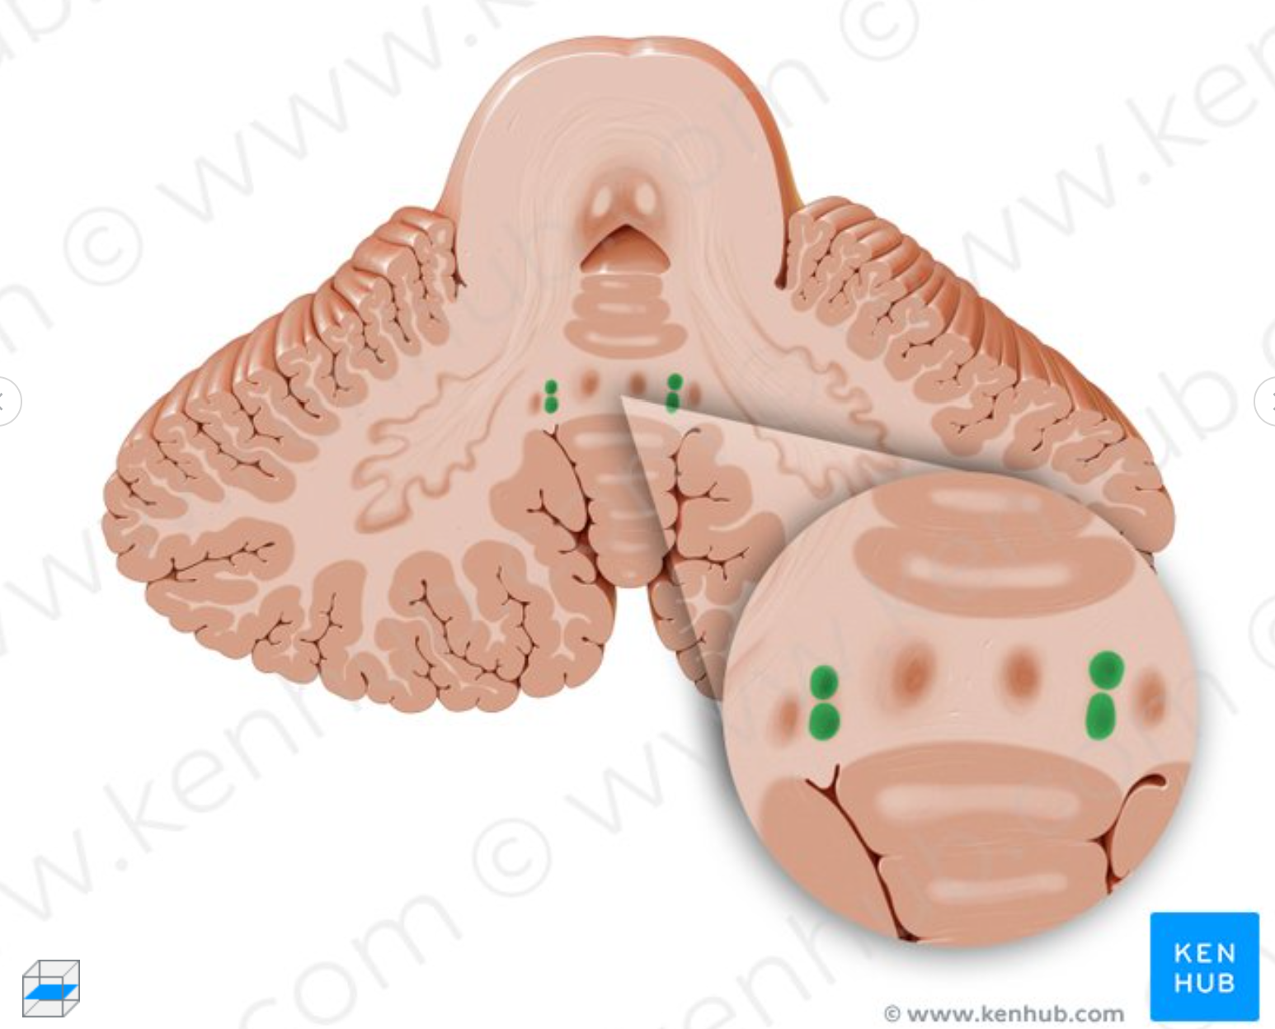
Deep cerebellar nuclei
Interposed nucleus
Dentate nucleus
Emboliform
nucleus
Fastigial nucleus
Globous
nucleus

Slide 7
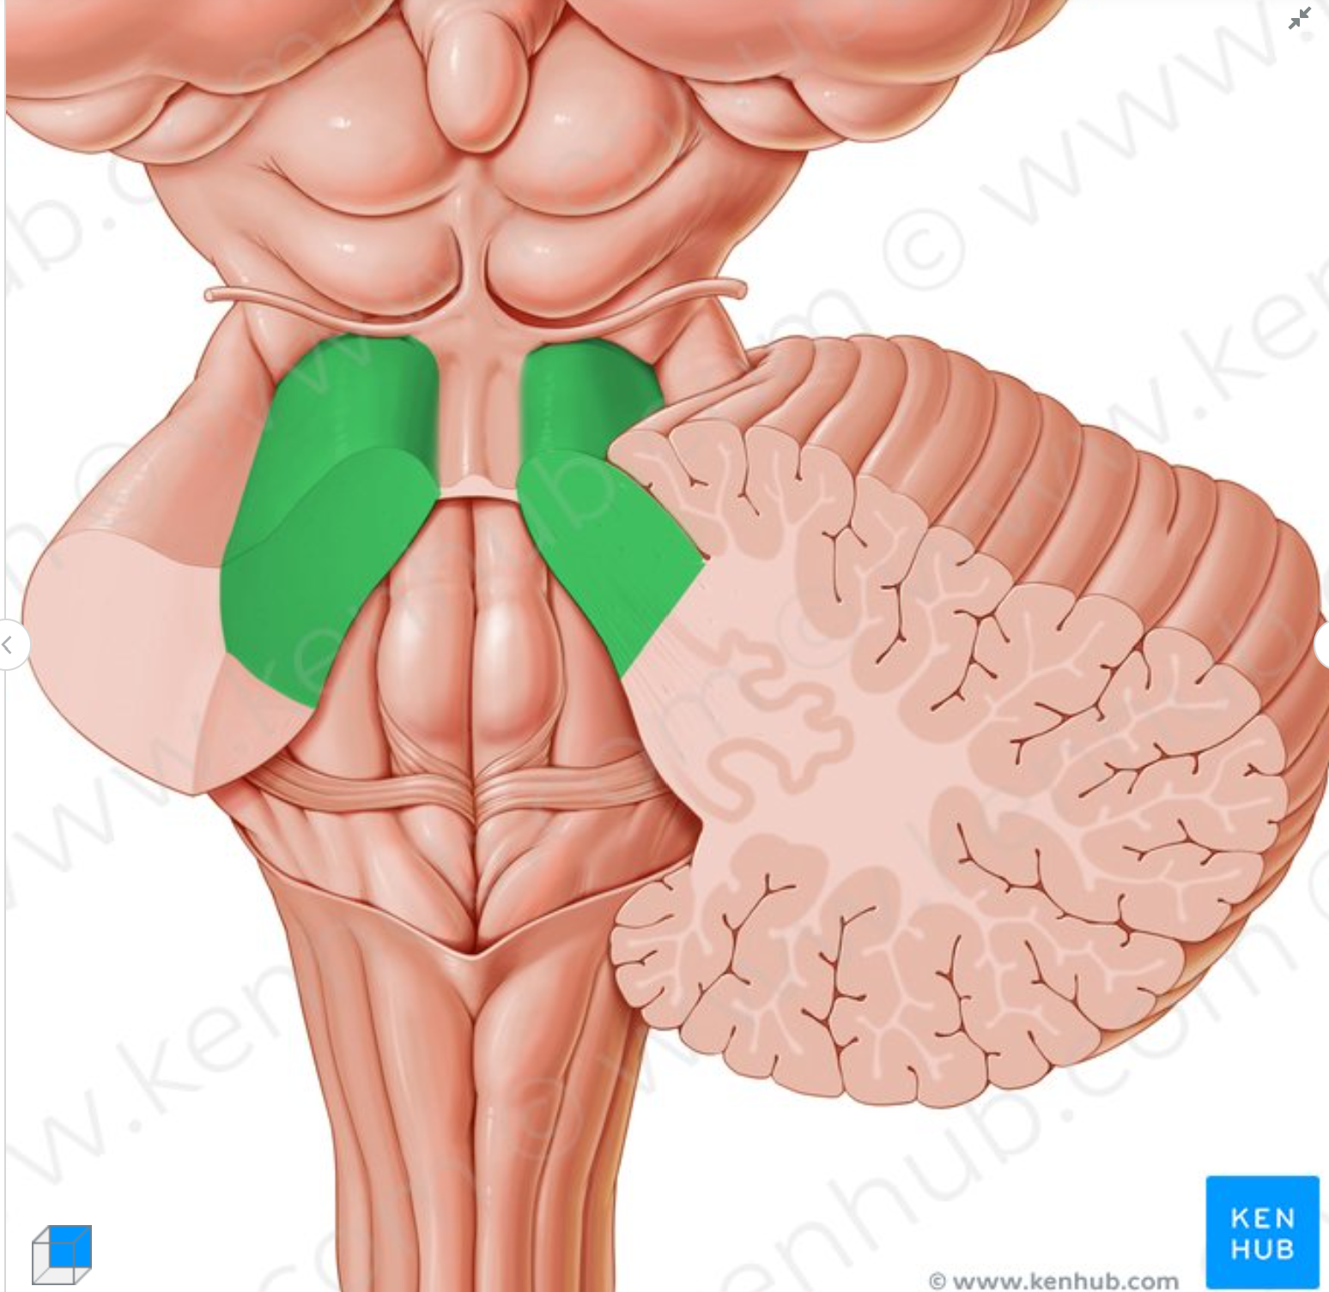
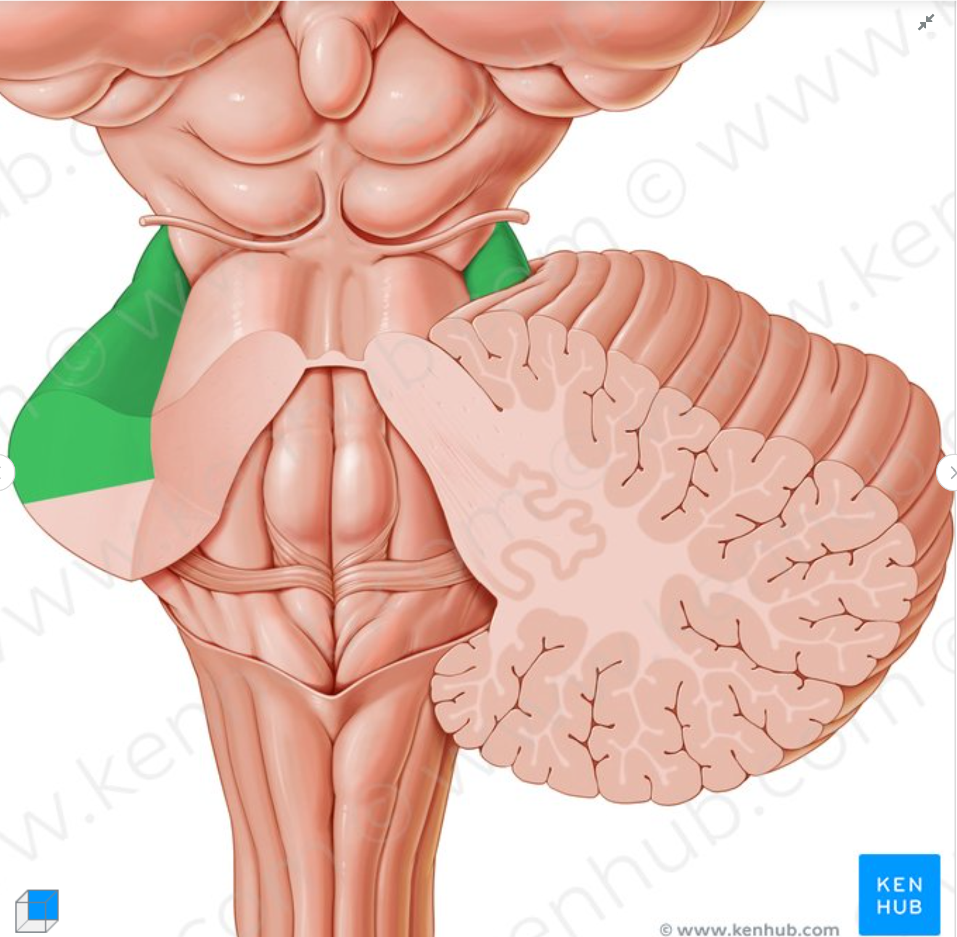
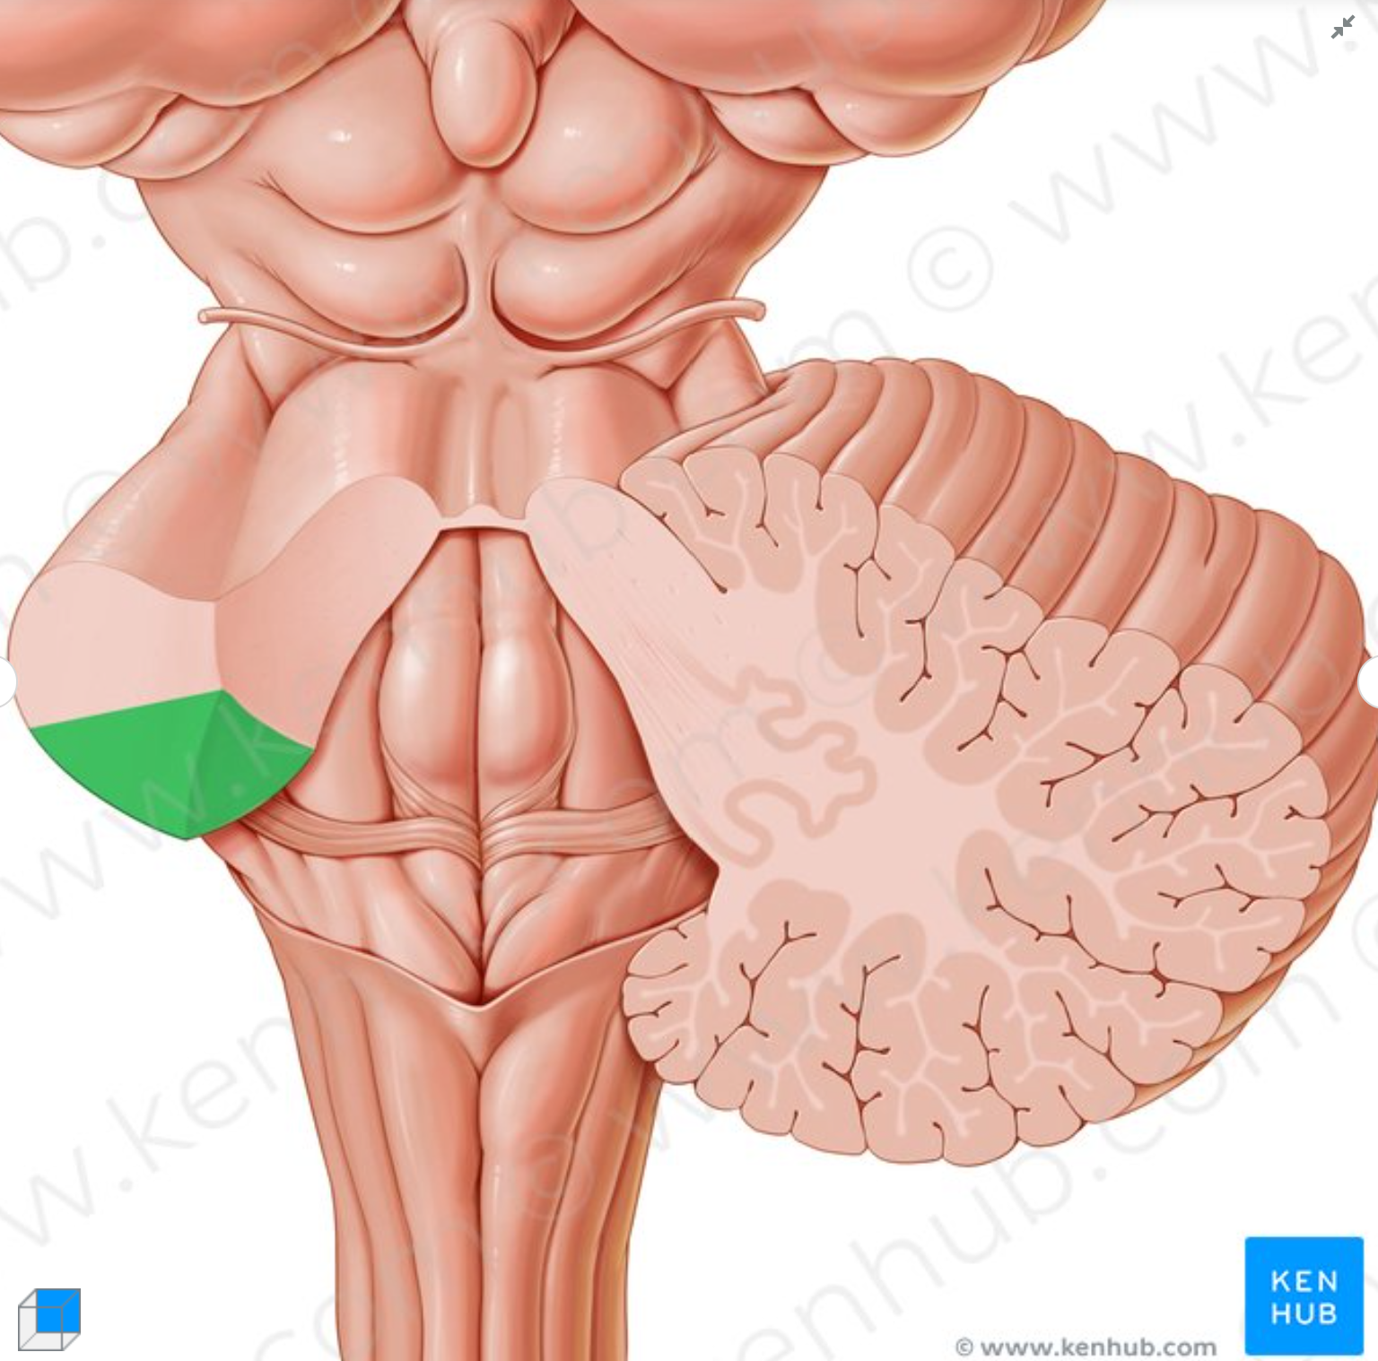
Cerebellar peduncles: the gateways of the cerebellum
Superior cerebellar
peduncles
Middle cerebellar
peduncles
Inferior cerebellar
peduncles

Slide 8
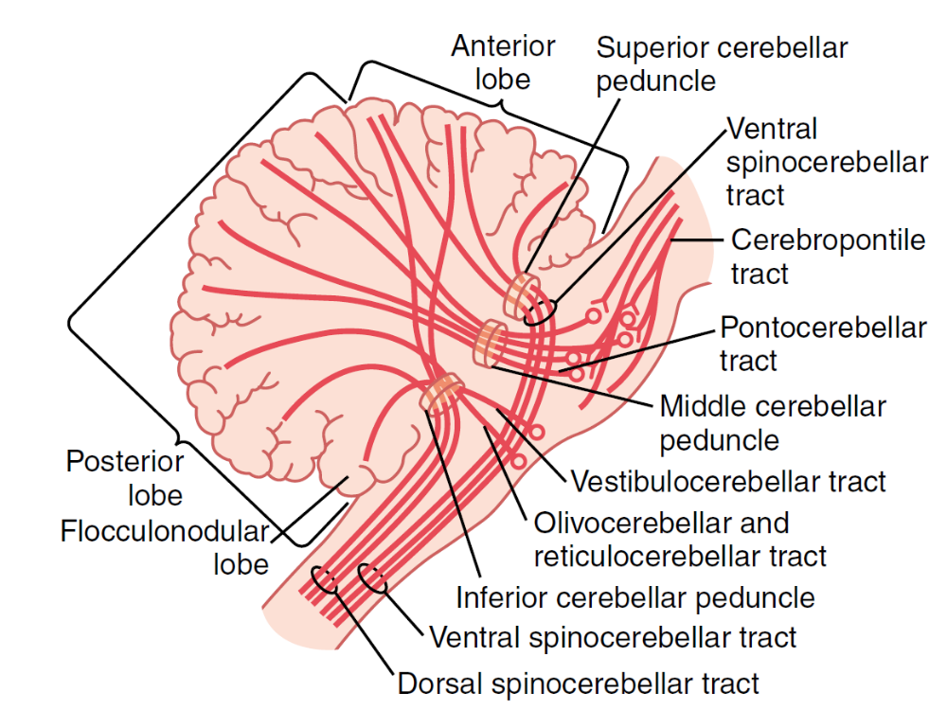
Cerebellar afferents: brain
Corticopontocerebellar
  From motor cortices and SSC to pontine nuclei and then to contralateral cerebellar lateral zones
Olivocerebellar
  Excited in the olives by projections from MC, basal ganglia, RF, and spinal cord
Vestibulocerebellar
  Terminate in the fastigial nucleus and the flocculonodular lobe
Reticulocerebellar
  Terminates mainly in the vermis

Slide 9
Cerebellar afferents: body
Dorsal spinocerebellar tract
  Signals from muscle spindles, golgi tendons organs, skin tactile receptors, joint receptors
Ventral spinocerebellar tract
  Corticospinal and rubrospinal tracts collaterals
  Ventral horns of the spinal cord motor pathways - efference copy of the anterior horn motor drive
Dorsal columns nuclei of the medulla (cuneatus and gracilis)
Spinoreticular and spino-olivary pathways (relayed in the reticular formation and the olive)

Slide 10
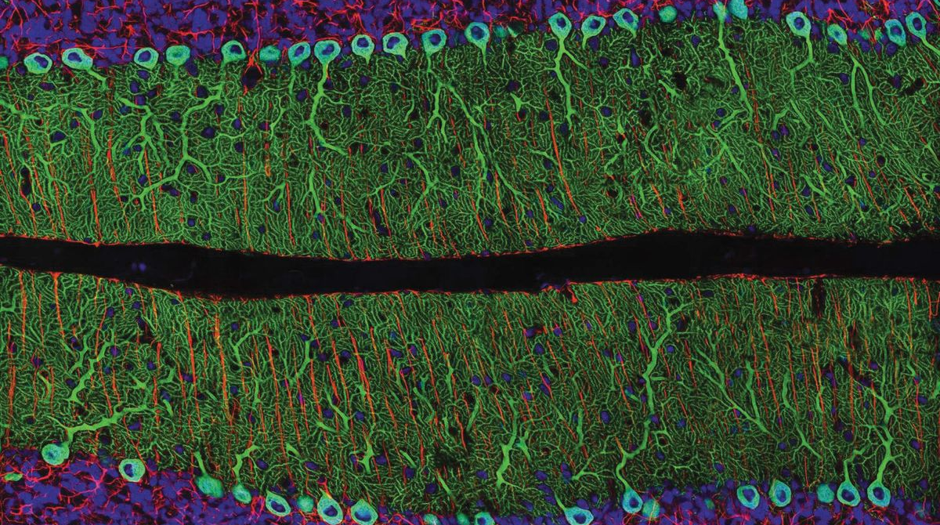
Cells of the cerebellum

Slide 11
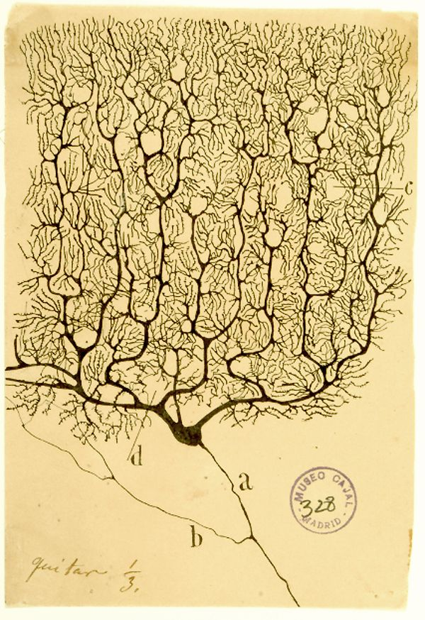
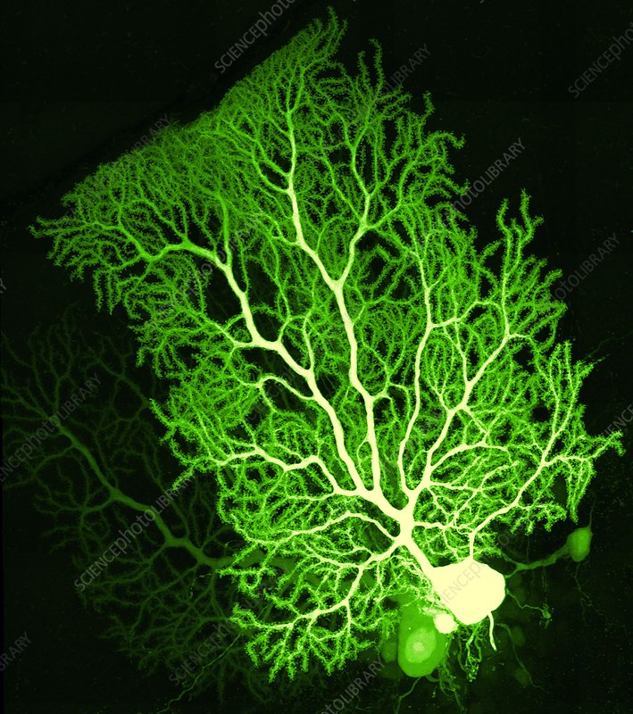
Neuronal circuitry: Purkinje cells

Slide 12
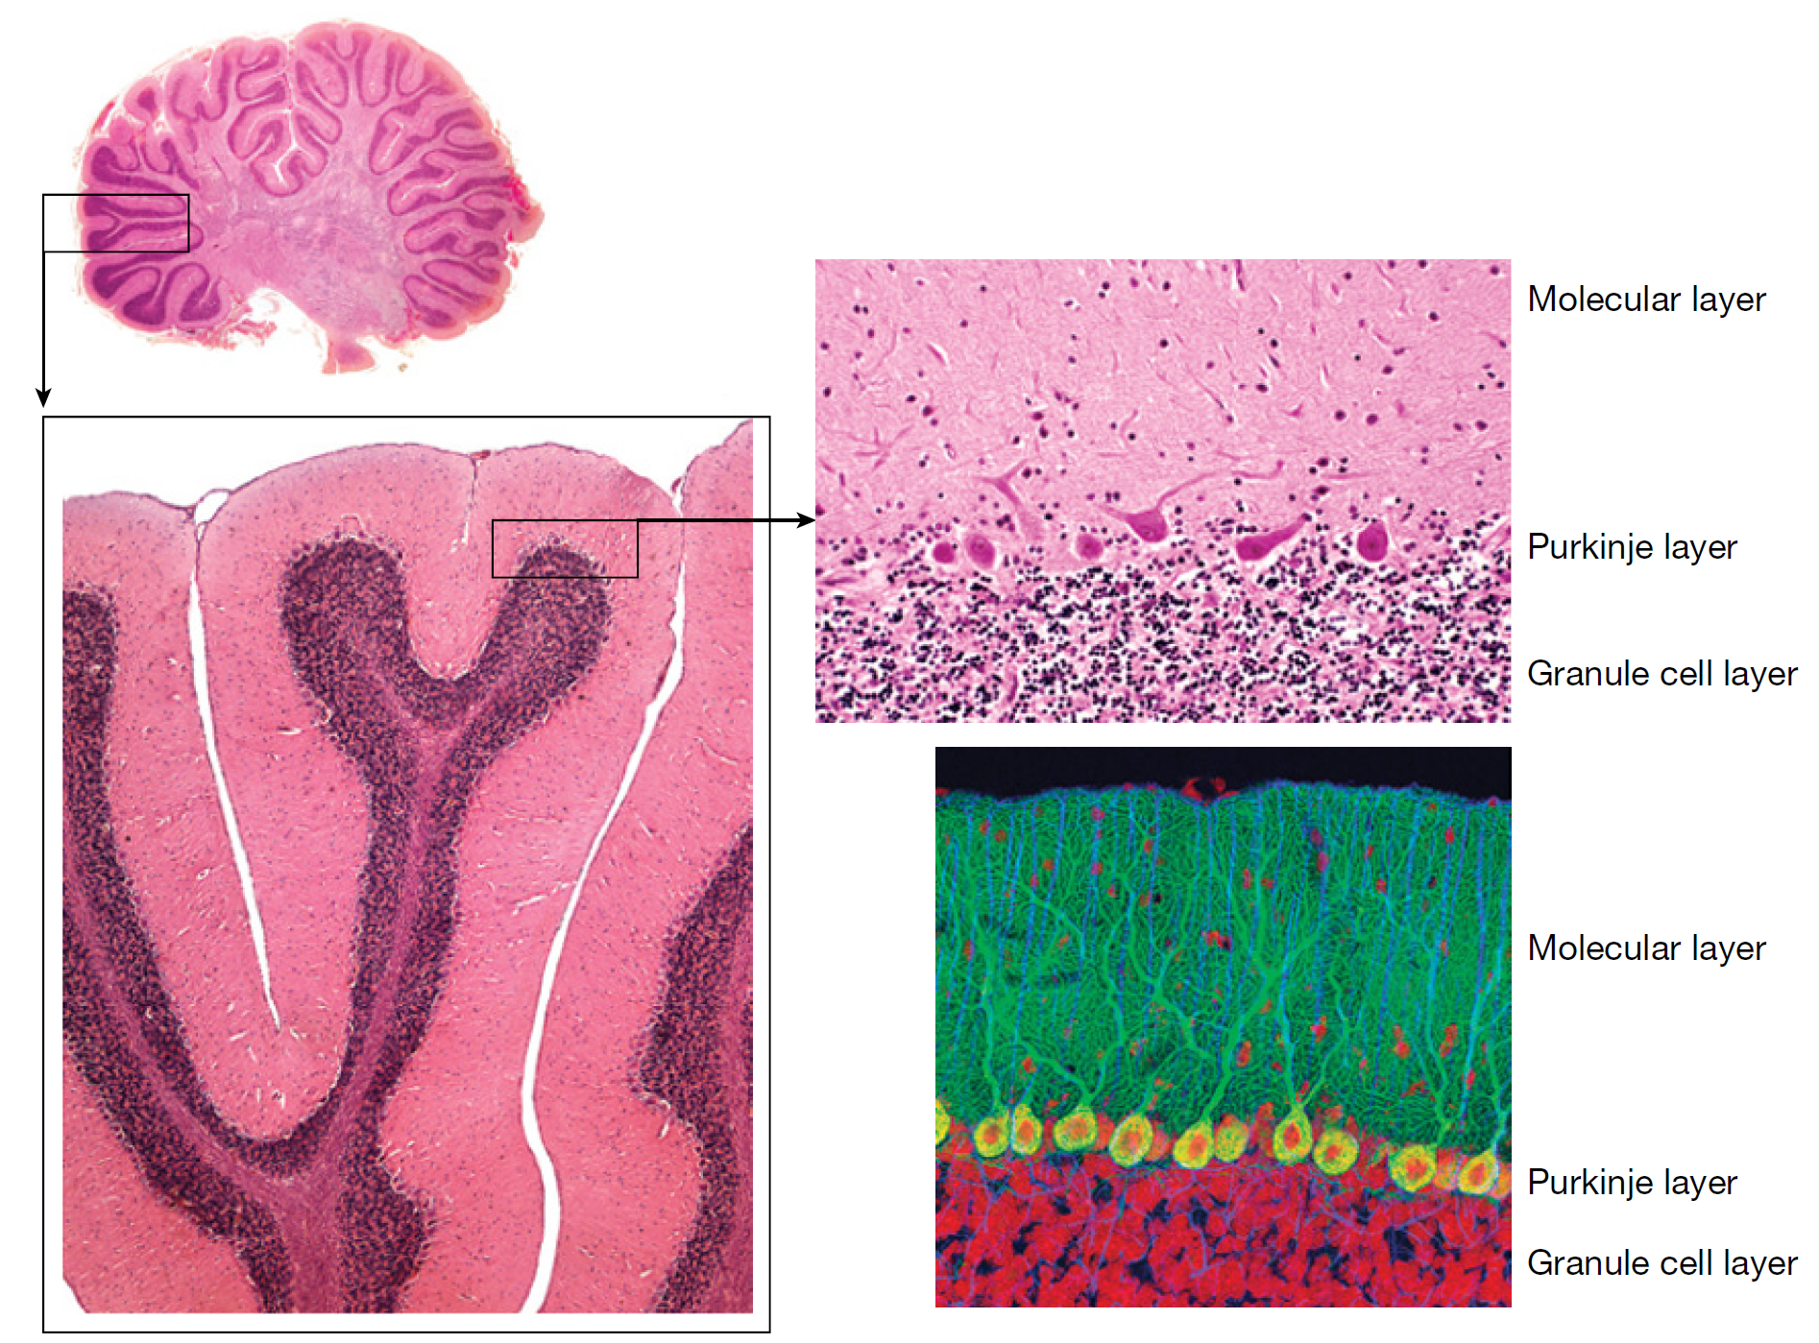
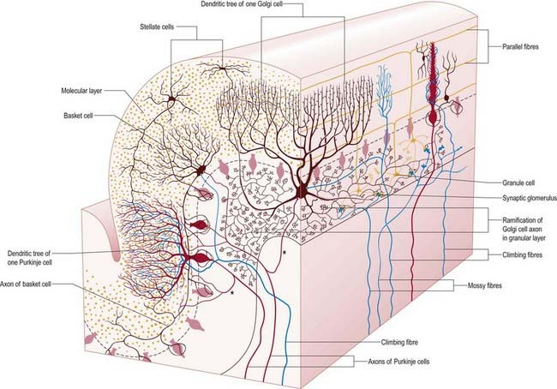
Neuronal circuitry
30 million repeated functional units along the cerebellum

Slide 13
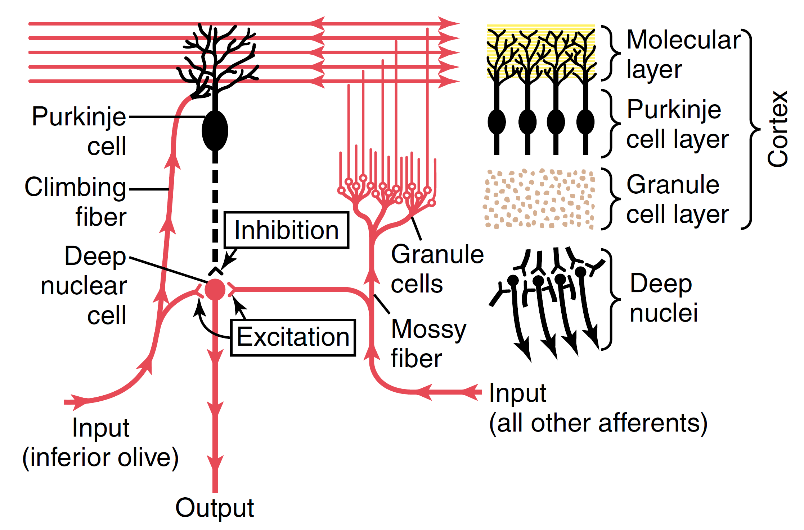
Neuronal circuitry
Input cells:
Purkinje cells - PC, inhibitory
Granule cells - GC, excitatory
Output cells:
Deep nuclei cells - DNC, excitatory
Projections (excitatory):
Climbing fibers - CF (medulla’s inferior olives)
Mossy fibers - MF (brain, brainstem, spinal cord)
Parallel fibers - PF (from granule cells)

Slide 14
Neuronal circuitry
Synapses:
CF → PC - Strong input (300 synapses/CF/PC, causing complex firing)
MF → GC
PF → PC - Weaker inputs but numerous (80000-20000 PF connect to 1 PC, causes simple firing)
CF → DNC
MF → DNC
PC → DNC - Inhibitory
1
3
2
6
5
4

Slide 15
Cerebellar efferents
1
2
3
Balance and posture
Agonist/antagonist muscles coordination
Sequential motor activities
Cerebellar cortex
Intermediate
zone
Red nucleus and
Reticular
formation
Lateral
zone
Vermis
Deep
nuclei
Dentate
nuclei
Fastigial
nuclei
Interposed
nucleus
Basal ganglia
Afferents
Thalamic
midline nuclei
Ventrolateral and
Ventroanterior
thalamus
Output
Medulla
And pons
Ventrolateral and
Ventroanterior
thalamus
Cortex
Cortex

Slide 16
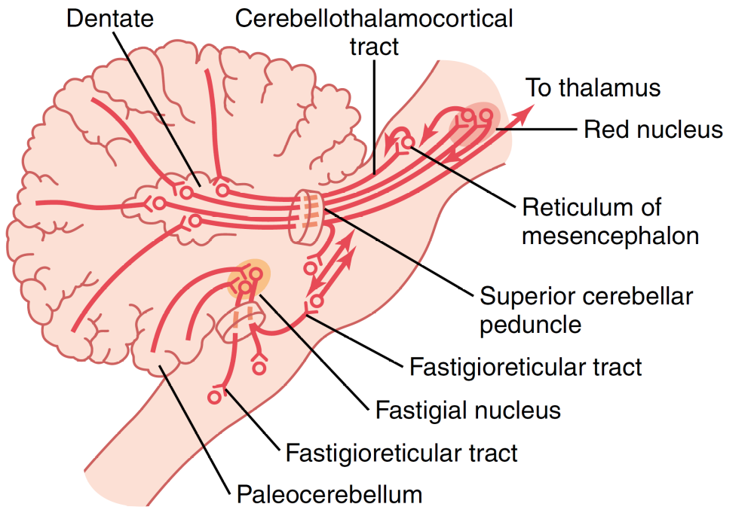
Cerebellar efferents
Cerebellar cortex
Deep
nuclei
Afferents
Output

Slide 17
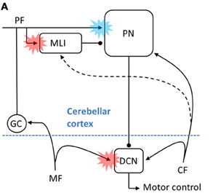
Learning in the cerebellum
↑Delay
PC
Attempt 1
Error ↑
GC
CF
DNC
MF
↓Delay
PC
Attempt ~N
Error ↓
GC
CF
DNC
MF

Slide 18
Basic cerebellar processing
Motor
Intermediate
zone
Movement begins
Movement ends
Prevent overshooting movements
Refine ballistic movements
Turn on agonist muscles
Turn off antagonist muscles
Turn off agonist muscles
Turn on antagonist muscles
Planning and coordination of complex actions, including speech
Planning and timing of sequential actions
Prediction of progression of auditory and visual inputs
Non-Motor
Lateral zone
Cerebellum
Cortex

Slide 19
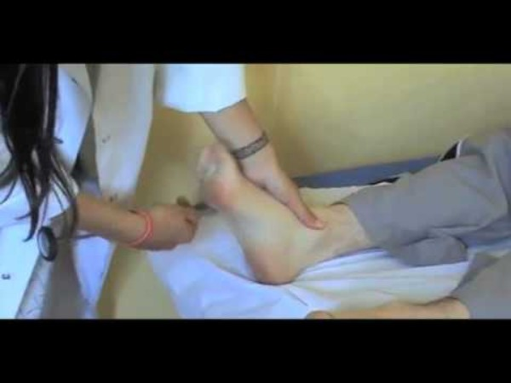
Cerebellar disfunction
Often damage to deep cerebellar nuclei
Dysmetria and ataxia
  Inability to predict extent of movements → Dysmetria
  Overshooting of movements and overcompensation of opposite movements → Ataxia
  Can also be caused by lesion of spinocerebellar tracts
Inability to perform rapid movement sequences → Dysdiadochokinesia
Difficulties in talking → Dysarthria
Inability to fix eyes in one spot → Cerebellar nystagmus
Loss of muscular tone → Hypotonia
Notes:
Video 1—Friedreich's Ataxia: A patient with Friedreich's ataxia, a gait disorder due to both cerebellar and proprioceptive ataxia, has imbalance, staggers, and has difficulties in making a half-turn. Because of difficulties with tandem walking, the patient requires the intermittent support of a wall. The patient has dysmetria during nose--finger and finger chase tests, and instability in a standing position with the feet together because of cerebellar ataxia. There is an obvious loss of balance when the patient's eyes are closed because of the proprioceptive component of the ataxia. Saccadic ocular pursuit and square-wave jerks due to fixation instability are shown, as well as diffuse abolition of the reflexes and right extensor plantar reflex. Video 2—Ataxia with Oculomotor Apraxia Type 1: Choreic movement of the hands and trunk with cervical dystonia in a patient with ataxia with oculomotor apraxia type 1. Video 3—Ataxia Telangiectasia: Right horizontal gaze-evoked nystagmus and nasal as well as temporal telangiectasias in a patient with ataxia telangiectasia. Video 4—Oculomotor Apraxia Type 1: Oculocephalic dissociation in a patient with ataxia with oculomotor apraxia type 1. During the rotation of the head, a dissociation is expressed as a delay between the movement of the eyes following that of the head.

Slide 20
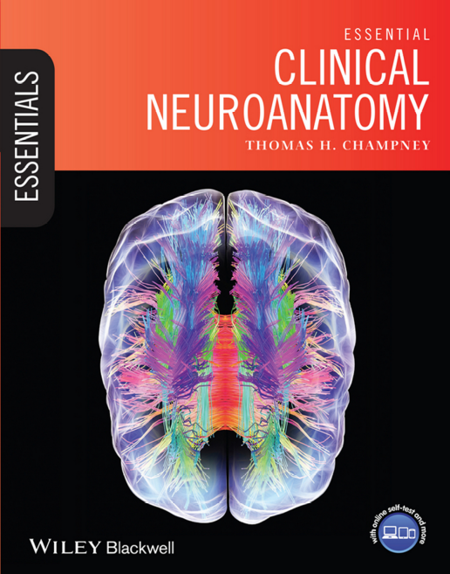
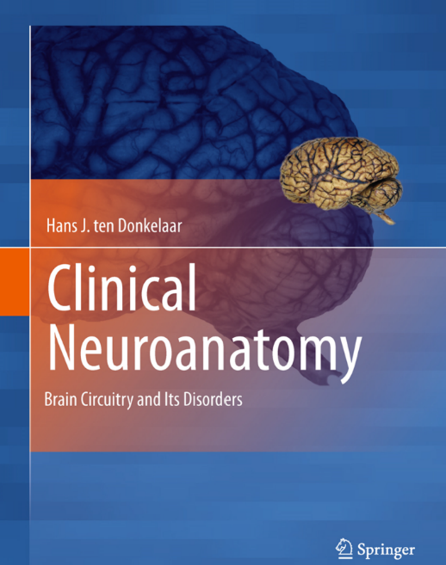
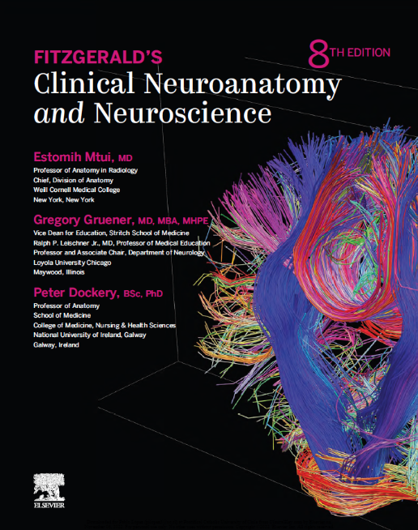
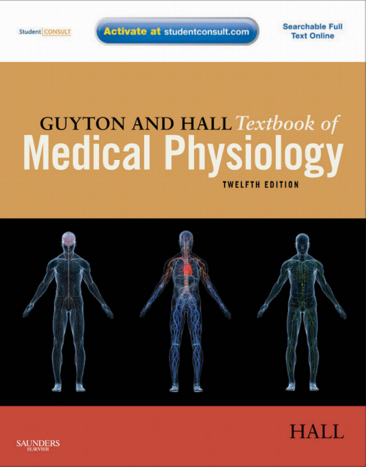
Questions?
Specific reading:
  Clinical Neuroanatomy, Hans J. ten Donkelaar, ISBN 978-3-642-19133-6
  Clinical Neuroanatomy and Neuroscience, Estomih Mtui & Gregory Gruener & Peter Dockery, ISBN 9780702079092
  Thomas H. Champney - Essential Clinical Neuroanatomy 1th ed (2016) ISBN: 978-1-118-43993-7
  Guyton and Hall Textbook of Medical Physiology 12th ed (2011) ISBN: 978-1-4160-4574-8
Contact:
vm491@cam.ac.uk

